Slide 1
Sealing
Aerospace Manufacturing Core Study Guide
“AMCSG-203”
Tools & Processes

Slide 2
Sealing

Slide 3
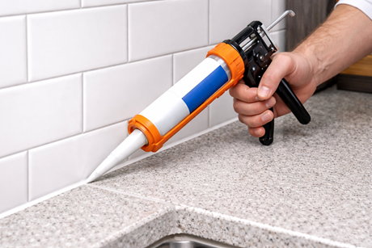
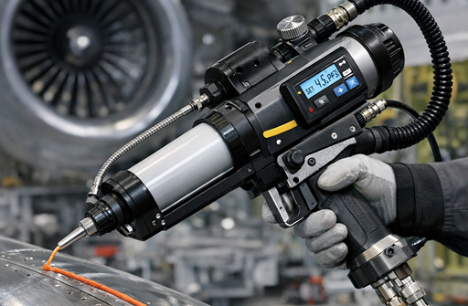
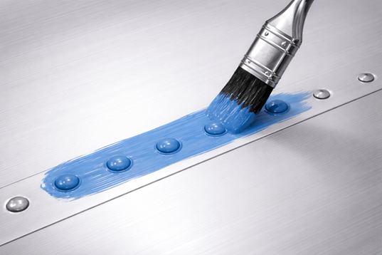
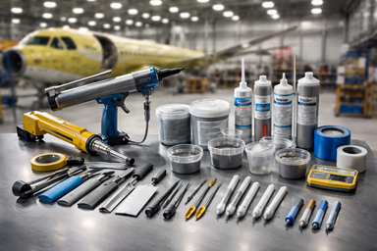
Everybody Knows What Sealant Is, Right?
ChatGPT / Matt Pierce, 2026
ChatGPT / Matt Pierce, 2026
ChatGPT / Matt Pierce, 2026
ChatGPT / Matt Pierce, 2026
Notes:
Image Credits:
ChatGPT – “Sealant gun” – “make a photo showing a hand holding a caulking gun sealing a kitchen counter top with white sealant”
ChatGPT – Sealing rivets – “show sealant being painted over rivet heads on a strip of aluminum aircraft skin” + “make it a single photo. make it training-manual clean. make the brush stroke thick over the strip of rivets. make the sealant blue. make the brush hairs black. make the brush handle silver.” + “make the brush head narrower. make the rivet heads 4x smaller. use half as many rivet heads. show only the lower strip of rivets (remove the top strip)”
ChatGPT - make a picture of a sealant gun used in aerospace manufacturing. Show how is different from a home sealant gun.
ChatGPT - make a photo showing all the tools used to apply sealant in aerospace manufacturing

Slide 4
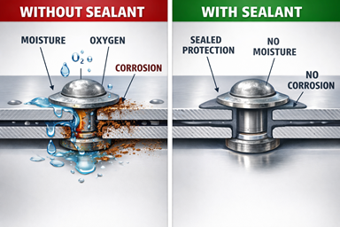
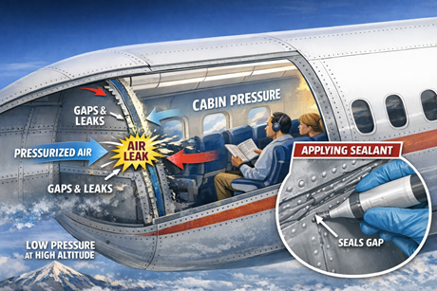
Sealant Purposes (1 of 2)
Sealants are a critical component for aircraft.
They provide…
1. Corrosion Protection
2. Maintaining Cabin Pressure
ChatGPT / Matt Pierce, 2026
ChatGPT / Matt Pierce, 2026
Notes:
ChatGPT – “Corrosion Protection”: “picture emphasizing purpose of sealant for corrosion protection” + “create a with vs without sealant split image”
ChatGPT – “Maintain Cabin Pressure”: “picture emphasizing purpose of sealant for maintaining cabin pressure in aircraft” + “show sealant applied on the inside (not the outside) in the zoom popup. remove the title at top "sealant for maintaining cabin pressure"

Slide 5
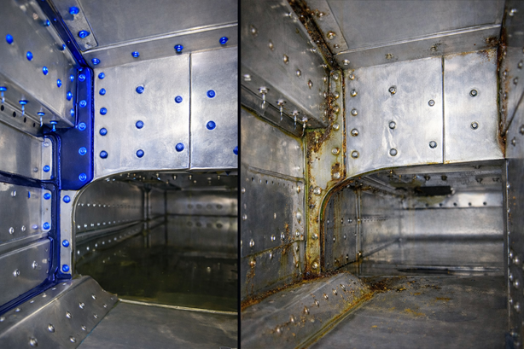
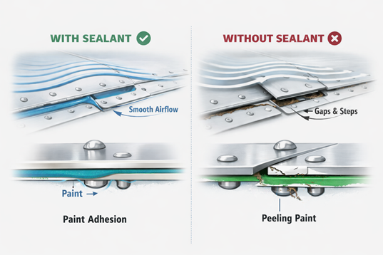
Sealant Purposes (2 of 2)
3. Preventing Fuel Tank Leaks
4. Maintaining Adhesion & Aerodynamics
ChatGPT / Matt Pierce, 2026
ChatGPT / Matt Pierce, 2026
Notes:
ChatGPT – “Maintain fuel in tanks”: “picture emphasizing purpose of sealant for maintaining fuel in tanks and preventing leaks” + “Sealant applied at joints, lap seams, fastener heads, and rib-to-skin interfaces show side by side with sealant, and without sealant (leaking)” + “make the rivets head 80 percent smaller on both pictures. Emphasize the sealant on the left side. Emphasize no sealant on the right side and emphasize corrosion on the right side. Remove 90% of the leaking fuel from the right side.” + “make the black sealant blue on left picture so it really stands out. Ditto for the sealant at every rivet head on left picture. No changes to right picture.”
Maintaining Adhesion and Aerodymaics: ChatGPT “picture emphasizing purpose of sealant on skin of airplane for aerodynamics and for surface adhesion” + “make a with vs without sealant comparison image” + ”remove the top title bar in blue "lap joint sealing: with vs without sealant"
+ “change the lower part of both pictures away from corrosion and moisture barrier...change it to surface adhesion for paint.
“

Slide 6
Q&A

Slide 7
Practice Q&A’s (Q1-Q8)
Q5: How does sealant protect liquid containing vessels (fuel tanks, lavatory floors, etc.)?
A: Prevents outright leaks, or corrosion that leads to leaks
Q6: How does sealant improve the skin of an airplane?
A: 1. Smoother airflow, and 2. Better paint adhesion at gaps and fastener heads
Q7: What does sealant help prevent since there are so many different metal alloys in contact on an airplane?
A: Corrosion
Q8: What are the only two tools you can use to safely apply solvents to prep a metal surface?
A: 1. Natural cotton cloth, or 2. Natural bristle brush
Q1: How do you apply sealant over fastener heads?
A: Using a brush
Q2: How does sealant protect at and around metal fasteners?
A: Corrosion Protection
Q3: How does sealant protect gaps and holes in metal surfaces?
A: Corrosion Protection
Q4: How does sealant protect the air in a cabin and flight deck?
A: Maintains Cabin Pressure

Slide 8
Practice Q&A’s (Q9-Q16)
Q13: What type of sealant shrinks the most?
A: Drying (because moisture evaporates so mass is lost)
Q14: How are pre-mixed sealants kept fresh?
A: Stored in freezer
Q15: Name of sealants used on exterior of plane to guarantee aerodynamics of airplane?
A: Aerosmooth sealant
Q16: What is the lower temperature threshold for sealant to still bond well on metal?
A: 60°F (guess you need a heater in the plane during winter for proper cure/dry)
Q9: Name of process to rough-up material surface before applying sealant?
A: Abrading
Q10: What common cleaning agent should NEVER be used to prep a surface or clean a tool?
A: Soap!
Q11: Does it matter if a cleaning solvent dries before you can wipe it off with a dry cloth?
A: Yes! Residue = Contamination
Q12: What are three types of sealants?
A: 1. Drying, 2. Curing, and 3. Pliable (like putty)

Slide 9
Thank You
Matt Pierce - mpierce710006@gmail.com - linkedin.com/in/mpiercead576/
https://github.com/DataResearchLabs/study_guide_intro_aerospace_mfg

